Slide 1
Functions

Slide 2
Functions
So far all the programs we’ve written contain all of the source code in a single “chunk”
This is fine for small programs, but what if you had a program containing thousands of lines of code??
Functions allow you to break up a program into smaller, more manageable portions
Each function performs a specific task and needs to be written only once
You can then use (“call”) the function as many times as necessary

Slide 3
Functions
Functions usually take some input (known as parameters or arguments), perform some actions using that input, and then return a result (output).
Example: for a function that calculates the maximum of three numbers, parameters: 3 numbers actions: find the maximum number returns: the maximum number

Slide 4
Functions
calculate max
9
5
9
3
inputs
(parameters or arguments)
actions
output
(return value)

Slide 5
Functions
We’ll be discussing two kinds of functions:
“Built-in” functions are included as part of the Python language. These functions are already written by the Python developers – you can call them without having to define what they do.
“Custom” functions are functions that you define yourself. To use a custom function, you must first define the function’s parameters, actions, and return value. Then you can call the function from any later point in your program.

Slide 6
Built-in functions
Python has several functions that are considered a standard part of the language. We’ve used several of these already:
type(...) takes an expression as a parameter, returns the data type of that expression
input(…) takes the string to display as a parameter, returns whatever the user just typed in (as a string)
int(...), float(...), str(…) takes an expression as a parameter, returns that expression converted to int, float, or str

Slide 7
Built-in functions: examples
type(42) is calling the type(…) function using 42 as an argument. It returns the data type ‘int’.
type(42)
figure out the data type of 42
42
int
input
actions
output

Slide 8
Built-in functions: examples
n = int(input(“Enter a number ”)) involves two nested function calls!
The first call is to input(…), which uses the string “Enter a number ” as its argument. It displays that string, waits for user input, and returns whatever the user types (as a string).
The return value from input(…) is used as an argument to the int(…) function, which returns the string converted to an integer.
Finally, the integer returned from the int(…) function is stored into the variable n.

Slide 9
Built-in functions: examples
“Enter a number ”
input(…) display the string argument, then read what the user types, as a string
Argument for input(…)
whatever the user just typed, as a string
int(...) convert whatever the user just typed into int form
Return from input(…),
argument for int(…)
converted result, as an int
Return from int(…)

Slide 10
Built-in functions: examples
Note that when calling any function, you supply the arguments (inputs) between parentheses.
In the code type(42), the argument to the function type(…) is 42
In the code int(input(“Enter a number ”)), the argument to the function input(…) is the string “Enter a number ”. The argument to the function int(…) is the value returned from input(…).

Slide 11
Built-in math functions
Python modules are files that contain a collection of related functions. Python includes a module named math that implements many common math operations.
To call any function from this module, you must include the line import math before the function call. You can then call any function from it by typing math, followed by a dot, followed by the function’s name and arguments.

Slide 12
A few built-in math functions
Replace the ... with the number to use as the argument. Arguments for the trig functions must be expressed in radians (not degrees).
Function | Returns
math.sqrt(...) | The positive square root of the argument
math.fabs(…) | The absolute value of the argument
math.sin(...) | The sine of the argument
math.cos(...) | The cosine of the argument
math.tan(...) | The tangent of the argument
Note: math.pi (which is a variable, not a function) will give you the value of π, accurate to about 15 decimal places.

Slide 13
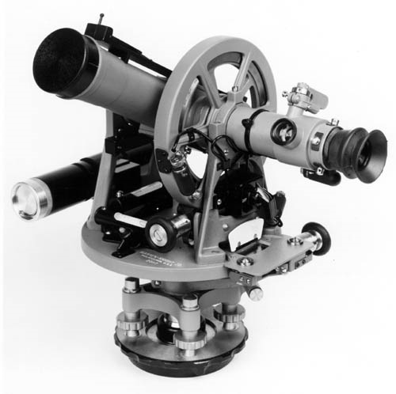
Built-in math functions: example
One way to measure the height of a tall building is by using an instrument known as a theodolite. A theodolite allows you to measure angles.
Given the angle to the top of a building and the distance to the building’s base, you can compute the building’ s height!

Slide 14
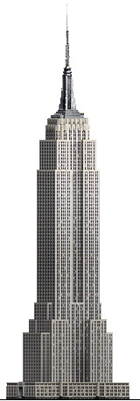
Built-in math functions: example
tan θ = h / d, so we can calculate the height by using h = d tan θ
Height of building, h
Angle to top, θ
Distance to base of building, d

Slide 15
Built-in math functions: example
import math
d = float(input("Enter horizontal distance (in ft): "))
theta = float(input("Enter angle to top (in degrees): "))
# angle must be converted from degrees to radians
# (180 degrees = pi radians)
theta = theta*math.pi/180
h = d*math.tan(theta)
print("The building is", h, "ft tall.")

